Slide 1
Chapter 4
Designing Webpages with CSS

Slide 2
Objectives
You will have mastered the material in this chapter when you can:
Explain the importance of separating design from content
Describe Cascading Style Sheets (CSS)
Define inline, embedded, and external styles and their order of precedence
Describe a CSS rule and its syntax
Explain the difference between a selector, property, and value

Slide 3
Objectives (continued 1)
Create styles that use text and color properties
Explain the difference between inline and block content
Describe and use the CSS box model to apply margins, padding, and borders
Create an external style sheet and link it to an HTML page

Slide 4
Objectives (continued 2)
Create responsive images
Use float and clear properties
Create and style id and class attributes
Use a span element
Add comments to an external style sheet and validate a CSS file

Slide 5
Introduction
Creating a well-designed website that captures your audience’s attention is vital in attracting and obtaining new customers
Web developer can use formatting such as font styles, font colors, white space, and background colors or images to increase the visual appeal of the webpages
Cascading Style Sheets (CSS): language used to describe formatting of a document written in a markup language such as HTML 5
CSS determine the formatting for a webpage

Slide 6
Project — Format Webpages with CSS
The project in this chapter enhances a website with CSS
You apply styles to the HTML 5 elements on each page to give the site a certain look and feel
Roadmap
CREATE a CSS FILE
LINK HTML PAGES TO a CSS FILE
CREATE STYLE RULES
ADD COMMENTS to the CSS file
VALIDATE the CSS FILE

Slide 7
Using Cascading Style Sheets
Style rule defines the appearance of an element on a webpage
Style sheet is the set of CSS style rules
Provides a means to separate style from content because it gives the flexibility to redesign or rebrand a website
Important when maintaining a large website

Slide 8
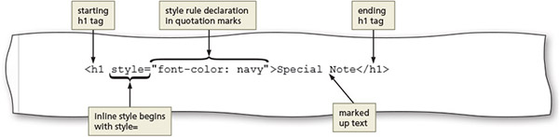
Inline Styles
Used to add a style to the start tag for an element, such as a heading or paragraph, using the style attribute
Figure 4–3

Slide 9
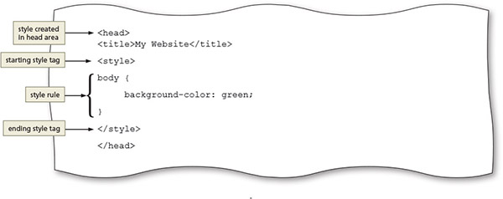
Embedded Style Sheets
Includes the style sheet within the opening <head> and closing </head> tags of the HTML document
Also called an internal style sheet
Figure 4–4

Slide 10
External Style Sheets
CSS file that contains all of the styles that can be applied to more than one page in a website
Also called a linked style sheet
Text file with the .css extension
To apply an external style sheet, link it (or attach it) to a webpage using a link in the head section of the webpage

Slide 11
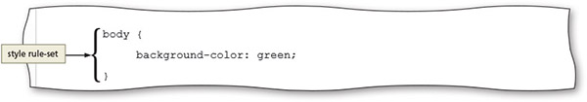
External Style Sheets (continued)
Provides flexibility to quickly change webpage formats because the styles used in it are applied to every page linked to it
Changing the look of an entire website is sometimes called reskinning the website
Figure 4–5

Slide 12
Style Sheet Precedence
Style sheets are said to “cascade” because each type of style has a specified level of precedence (or priority) in relationship to the others
CSS properties can be inherited from a parent element through a principle called inheritance
If a selector has more than one CSS rule, specificity determines which CSS rule to apply

Slide 13
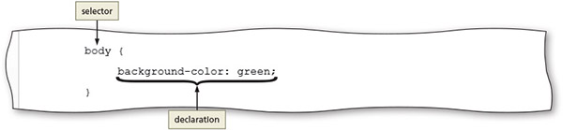
CSS Basics
Each CSS rule consists of a selector and a declaration
Figure 4–6

Slide 14
CSS Basics (continued 1)
Selector: part of the statement that identifies what to style
Any HTML 5 element such as body, header, nav, main, or footer may be a selector
May also be the value of an id or class attribute
Declaration defines the exact formatting of the style
Consists of a property and a value, separated by a colon and followed by a semicolon (;)
For each property, the declaration includes a related value that identifies the particular property value to apply

Slide 15
CSS Basics (continued 2)
The property identifies the style quality or characteristic to apply
Color (text color)
Background-color
Text-indent
Border-width
Font-style

Slide 16
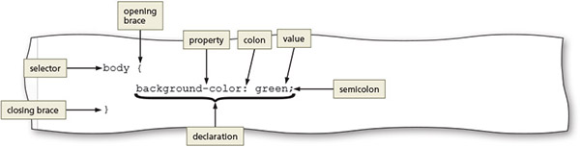
CSS Basics (continued 3)
Figure 4–7

Slide 17
CSS Text Properties
You can use CSS styles to format webpage text in a variety of ways
Fallback values are the additional values provided for the font-family property in case the browser does not support the primary font
CSS measures font sizes using many measurement units, including pixels, points, and ems, and by keyword or percentage

Slide 18
CSS Text Properties (continued)
Unit | Definition | Example | Comments
em | Relative to the default font size of the element | font-size: 1.25em; | Recommended by W3C; sizes are relative to the browser’s default font size
% | Relative to the default font size of the element | font-size: 50%; | Recommended by W3C; sizes are relative to the browser’s default font size
px | Number of pixels | font-size: 25px; | Depends on screen resolution
pt | Number of points | font-size: 12pt; | Use for printing webpages
keyword | Relative to a limited range of sizes | font-size: xx-small; | Sizes are relative to the browser’s default font size, but size options are limited
Table 4–2 Font Size Measurement Units

Slide 19
CSS Colors
HTML uses color names or codes to designate color values
Three types of color codes can be used with CSS
Hexadecimal values consist of a six-digit number code that corresponds to RGB (Red, Green, Blue) color values
RGB (Red, Green, Blue) color values
HSL (hue, saturation, lightness) color values
To use a color in a style rule declaration, use the color value as the property value
For example, to style a background color as gray use: background-color: #808080;

Slide 20
CSS Colors (continued)
Color | Hexadecimal | RGB | HSL
Black | #000000 | rgb(0,0,0) | hsl(0, 0%, 0%)
White | #ffffff | rgb(255,255,255) | hsl(0, 0%, 100%)
Red | #ff0000 | rgb(255,0,0) | hsl(0, 100%, 50%)
Green | #008000 | rgb(0,128,0) | hsl(120, 100%, 25%)
Blue | #0000ff | rgb(0,0,255) | hsl(240, 100%, 50%)
Yellow | #ffff00 | rgb(255,255,0) | hsl(60, 100%, 50%)
Orange | #ffa500 | rgb(255,165,0) | hsl(39, 100%, 50%)
Gray | #808080 | rgb(128,128,128) | hsl(0, 0%, 50%)
Table 4–3 Color Values

Slide 21
Understanding Inline Elements and Block Elements
HTML elements are positioned on the webpage as a block or as inline content
A block element appears as a block because it starts and ends with a new line, such as the main element or a paragraph element
Inline elements are displayed without line breaks so they flow within the same line
Inline content always appears within block elements

Slide 22
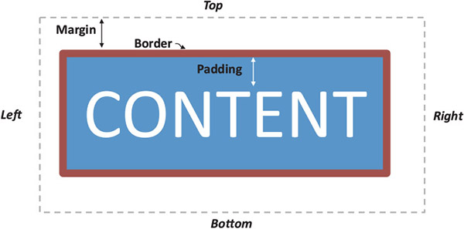
CSS Box Model
Each block element such as a header, nav, main, and footer element is displayed in a browser as a box with content
CSS box model describes content boxes on a webpage
Figure 4–9

Slide 23
CSS Box Model (continued)
Each content box can have margins, borders, and padding
Margin provides passive white space between block elements or between the top or bottom of a webpage
Border separates the padding and the margin of the block element
Padding is the passive white space between the content and the border of a block element

Slide 24
Creating an External Style Sheet
Used to create style rules that apply to more than one webpage in a website
Text file that contains the style rules you want to apply to more than one page in the website
Use a text editor to create and save a document with a .css extension
Link the CSS file to the webpages that should be formatted using the styles defined in the external style sheet

Slide 25
Selectors
A style rule begins with a selector, which specifies the element to style
An HTML element name
An id attribute value
A class attribute value
An id selector uses the id attribute value of an HTML element to select a single element
A class selector selects elements that include a certain class attribute
A descendant selector is used to create a style that applies to an element contained within another element

Slide 26
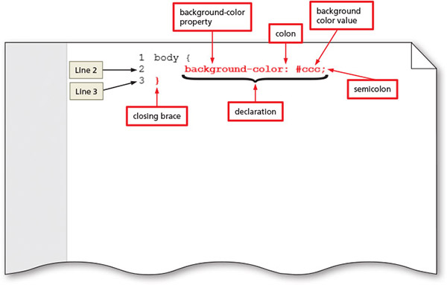
To Create a CSS File and a Style Rule for the Body Element
Figure 4–12

Slide 27
Linking an HTML Document to a CSS File
After creating a CSS file, link it to all the webpages that will use its styles
Insert a link element on the HTML page within the <head> and </head> tags
Link element uses two attributes
The rel attribute uses the stylesheet value to indicate the document is linked to a style sheet
The href attribute value specifies the file path or file name of the CSS file

Slide 28
Linking an HTML Document to a CSS File (continued)
Example of a link to a style sheet named styles.css and stored in the css folder:
<link rel="stylesheet" href="css/styles.css">
The type="text/css" attribute and value is also commonly used within a link element to reference a CSS file

Slide 29
Creating a Webpage Layout
To design a webpage to look the way you want, you cannot use HTML alone
Use CSS to design a webpage layout
Float property allows you to position an element to the right or left of other elements, while remaining within its parent element
Valid values: left, right, inherit, and none
Clear property is used to remove the float effect
Valid values: right, left, and both

Slide 30
Aligning Webpage Content
One way to align webpage content is to use the text-align property
Applies to block elements
Can use left (the default), center, right, or justify as its value
The following rule centers an h1 element:
h1 {
text-align: center;
}

Slide 31
Aligning Webpage Content (continued)
To center all of the elements of a webpage using a single style rule, set the left and right margins to auto
Set the width to 80%
Leave 20% of the page for margins

Slide 32
Creating Style Rules for Structural Elements
Header section appears at the top of a webpage
Needs formatting that makes the header contents stand out and attract visitors to the page
Nav section should be formatted differently from the other structural elements
Should be prominent and easy to find on the webpage
Each page contains different content within the main element
Must create various style rules to style the content for each page

Slide 33
Creating Style Rules for Structural Elements (continued)
Use a list for navigation links
To make the navigation links more appealing on the webpage, you can format them with CSS
CSS list properties
Used to control the appearance of numbered and bulleted lists
Making responsive images
Image resizes itself to accommodate the size of the browser window

Slide 34
Creating Style Rules for ID Selectors
The following example creates a style rule for an id attribute value of #contact:
#contact {
text-align: center;
}
The above style rule will center-align text within an element that has the id attribute value of contact

Slide 35
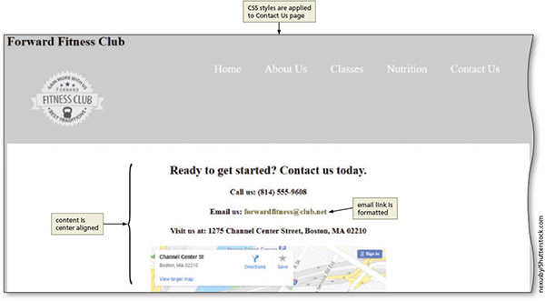
Creating Style Rules for ID Selectors (continued)
Figure 4–52

Slide 36
Creating Class Attributes
A class attribute name can be applied to more than one div or other HTML element on a webpage
Classes provide another level of control over the styling or formatting of specific elements on a webpage
Span element to group inline elements together on a webpage

Slide 37
CSS Reset
A CSS reset is a style rule that is applied to the webpage before any other style rule defined within the style sheet
Example of a CSS reset:
body, header, nav, footer {
margin: 0;
padding: 0;
border: 0;
}

Slide 38
Improving the Appearance of the Forward Fitness Club Website
You can improve a few other elements before this chapter is complete.
Remove all of the heading 1 elements from all the HTML pages
Change the background color for the body element to black to increase the contrast between the background and text

Slide 39
Adding Comments to CSS Files
Comments provide additional information about the area where the styles are applied or other helpful explanations, such as what the styles do
The syntax for a comment is as follows:
/* Place your comment here */

Slide 40
Validating CSS Files
Once a CSS file is created, it is validated to verify the validity of the CSS code
Confirms that all of the code is correct and follows the established rules for CSS
Many online validation services are used to assure that CSS code follows standards
Validation should always be a part of web development testing

Slide 41
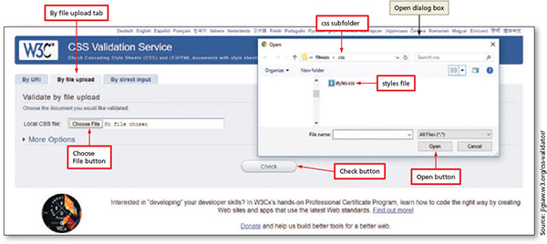
Validating CSS Files (continued)
Figure 4–75

Slide 42
Chapter Summary
In this chapter, you learned how to:
Create a CSS file with rules to style HTML elements on a webpage
Link the CSS file to all of the webpages for the fitness website

